Slide 1
Networks: Opportunities & Challenges
Jose Gonzales and
Kyle Macdonald

Slide 2
Four Core Principles Jane Wei-Skillern, Phd. UC Berkeley,
Mission, not organization
Trust, not control
Humility, not brand.
Node, not hub.
Notes:
What is the Outdoors Empowered Network’s/Latino Outdoors story around Networks .
How do you grow and organization and grow the field at the same time?
You can’t do the two of these without thinking about Network weaving- an “outsized impact” on the field.
What are the Network building blocks:
Four core principals:
Mission, not organization—Kyle
Trust, not control-- Jose
Humility, not brand-- Kyle
Node, not hub. --- Jose
Kyle- Mission not organization, Adopt a network midset.
Jose, I love that you asked this question. Maybe each of us takes a few minutes to share that genesis story.

Slide 3
Some Relevant examples of Networks
Transforming Youth Outdoors – TYO 15+ organizations, 400 people
Outdoor Alliance for Kids – OAK 100+ organizations, advocacy focus
ChangeScale –Bay Area 170 Orgs have participated. Just began (fall 2015) asking for membership.
The Children and Nature Network – 110 Grassroots Campaigns, 223 Nature Clubs for Families, 150 Natural Leaders 3,850,000 Youth & Children
Hike it Baby- 80 cities, 4 Countries
Notes:
What is the Outdoors Empowered Network’s/Latino Outdoors story around Networks .
How do you grow and organization and grow the field at the same time?
You can’t do the two of these without thinking about Network weaving- an “outsized impact” on the field.
What are the Network building blocks:
Four core principals:
Mission, not organization—Kyle
Trust, not control-- Jose
Humility, not brand-- Kyle
Node, not hub. --- Jose
Kyle- Mission not organization, Adopt a network midset.
Jose, I love that you asked this question. Maybe each of us takes a few minutes to share that genesis story.

Slide 4
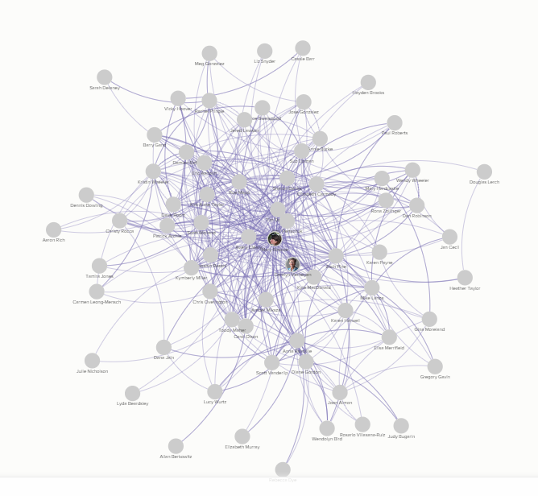
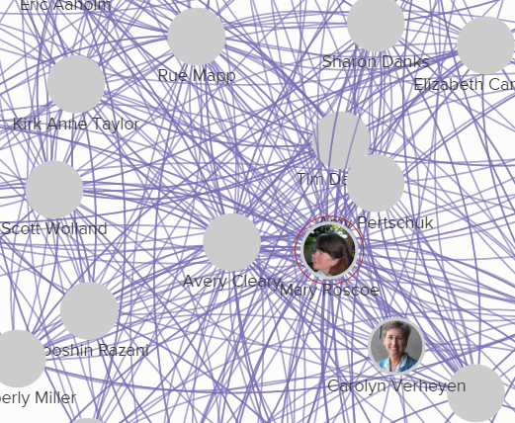
Network Mapping Tools
Notes:
What is the Outdoors Empowered Network’s/Latino Outdoors story around Networks .
How do you grow and organization and grow the field at the same time?
You can’t do the two of these without thinking about Network weaving- an “outsized impact” on the field.
What are the Network building blocks:
Four core principals:
Mission, not organization—Kyle
Trust, not control-- Jose
Humility, not brand-- Kyle
Node, not hub. --- Jose
Kyle- Mission not organization, Adopt a network midset.
Jose, I love that you asked this question. Maybe each of us takes a few minutes to share that genesis story.

Slide 5
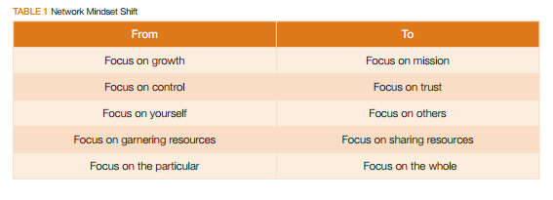
Shift…
Notes:
What is the Outdoors Empowered Network’s/Latino Outdoors story around Networks .
How do you grow and organization and grow the field at the same time?
You can’t do the two of these without thinking about Network weaving- an “outsized impact” on the field.
What are the Network building blocks:
Four core principals:
Mission, not organization—Kyle
Trust, not control-- Jose
Humility, not brand-- Kyle
Node, not hub. --- Jose
Kyle- Mission not organization, Adopt a network midset.
Jose, I love that you asked this question. Maybe each of us takes a few minutes to share that genesis story.

